Slide 1
Welcome to the Experiment
For this experiment you will need a timer (helps if you have a partner).
You will also need to use the Fitts Law Sheet attached on blackboard and a writing utensil.

Slide 2
Instructions
On the sheet you will see lines and boxes. Your job is to tap your writing utensil from the center of the line to the center of the box ten times. You will time how long it takes for you to complete ten taps. Count your taps out loud so you know when to stop timing. Ten taps constitute one trial. Record your time for each trial.

Slide 3
Instructions, continued
There are three different boxes. Complete a trial for each box.

Slide 4
Instructions, Part II
Turn your sheet over.
In the second part of the experiment, you will do the same thing as in the first part, except that you will only imagine tapping from the center of the line to the center of the box. Everything else is the same—you will time how long it takes you to complete ten “mental taps.” Complete a trial for each box. In this part, it is especially important you count your taps out loud so you know when to stop timing.

Slide 5
Debrief
This experiment is based off a finding in psychology called Fitts’ Law (Fitts, 1954). It is the finding that the amount of time it takes to make a movement follows a very precise mathematical formula based on the length of the movement (the distance from the line to the box) and the size of the target (the box).

Slide 6
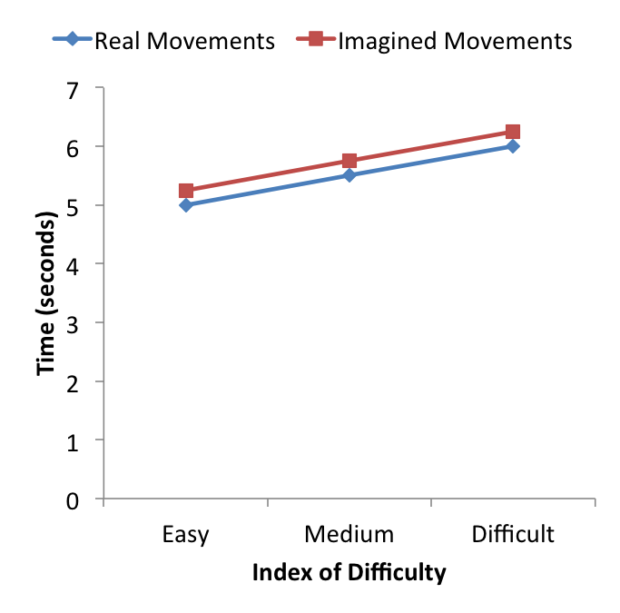
Results
Typical results show that there is a linear increase in time for movement as the index of difficulty increases. The same pattern holds for real movements and imagined movements, even though imagined movements require no real movement and you should be able to “tap” as quickly as you want to.

Slide 7
Conclusions
The results suggest that the processes involved in imagining movements are very similar to the processes involved in actually performing movements. Results from neuroscience experiments show that imagining a movement activates similar parts of the brain that are involved in real movement (Jeannerod, 2001). The reason is probably so that we can successfully plan and coordinate movements before we perform them.

